Slide 1


Bank of Baroda Hackathon - 2022
Technology Partner
Your Team Name : TechThriv
Your team bio : Devoloping products using machine learing and data science
Date : 20-09-2022

Slide 2
Problem Statement?
Why did you decide to solve this Problem statement?
Authenticating a customer using various methods and techniques is a significant challenge for many large corporations. Although there exist various procedures and tools which can make this process of customer authentication easier,
Traditional authentication techniques like authentication through credentials provided by an organization will provide more benefits, which enables every customer to access his/her data in a secured manner ,but it requires more human effort in remembering his own credentials to get access to his/her data and there will be high chances of malicious activities as well ,as these techniques provide fewer security features.
Authentication by voice is an emerging technique which will allow a customer to access their data by processing their voice through audio analysis techniques and provide them with a more secure way of accessing their data. It also reduces the human effort of remembering his or her credentials. So , creating an application that will provide all these features is a big accomplishment in this technological world.

Slide 3
User Segment & Pain Points
Which user /advertiser segment would be early adopter of your product & why?
The organizations which will store users' data confidentially and provide more secure way of authentication will be early adopters of this kind of product ,as they require a product which will facilitate their customers to easily access their data and prevent unauthorized access.
Organizations such as :
Banking
Educational Institutes
Government organizations
Social media platforms and e-commerce websites
5. IT/Software

Slide 4
Pre-Requisite
What are the alternatives/competitive products for the problem you are solving?
Deep learning is one of the most emerging technology in the field of Artificial Intelligence and computer science , which stands on the principal of providing computers/machines the ability to learn without being explicitly programmed ,which is inspired by brain’s own network of neurons.
Analyzing the voice of the customer and extract some useful features from the voice ,providing these features to a deep neural network , which will recognize the user by using provided features and underlying pattern of voice data .
Steps required to develop this product includes Data/voice extraction ,Analyzing the data ,Extracting useful features /underlying patterns, Training the deep neural network ,Evaluation and Making predictions, Deployment of the model and finally releasing it into the market .

Slide 5
Azure tools or resources
Azure tools such as : Microsoft Azure ML Studio Speaker recognition Speech to text text to speech speed tansulation azure database service

Slide 6
Any Supporting Functional Documents
Present your solution, talk about methodology, architecture & scalability
Life cycle of deep learing which includes data extraction, data cleaning & analysing, building model, trainng, testing.
Building the app, intergration of the model with app for the deployment.
Deploying on to the production server and collection real time authentication details from the users.
Employing regular retraining approach to improve the model accuracy.
By employing parallel computing technology we can reduce the load and increase the scale up the performance.

Slide 7
Key Differentiators & Adoption Plan
How is your solution better than alternatives and how do you plan to build adoption?
Widely accessible for authentication on mobile phones given that all phones have microphones.
Convenient most users as there is no need to remember any kind of login credentials.
Most useful for phone-based login.
Voices based authentication will be more secure than conventional authentication services.
Adding image recognition along with voice authentication for extra layer of security.
Non-tech-savvy audiences will also find it easy to access their information.

Slide 8
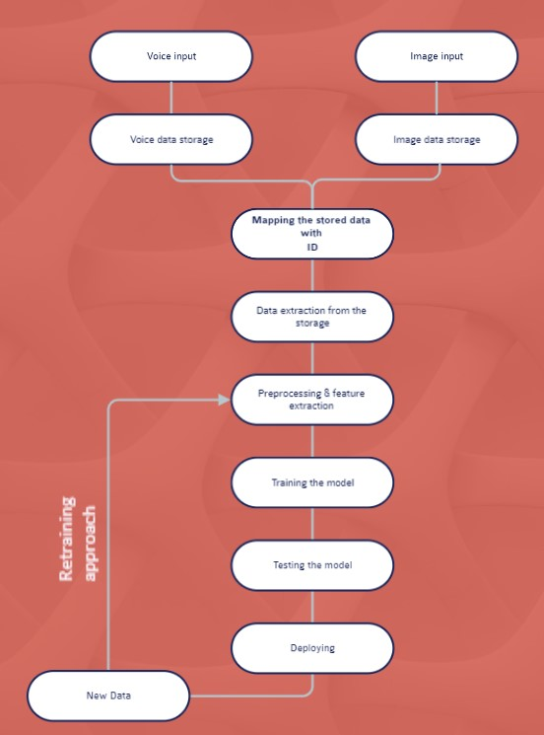
GitHub Repository Link & supporting diagrams, screenshots, if any
How far it can go?
By integrating different technology like face detection,
etc., we can further improve the security and reduce
number of unauthorized access.

Slide 9
Thank You
Team member names:
Shaik Mohammad Masood
Adike Sai Tharun Reddy

